Slide 1
Generative Adversarial Networks for Synthesizing New Data
Chapter 17
Javier Garcia

Slide 2
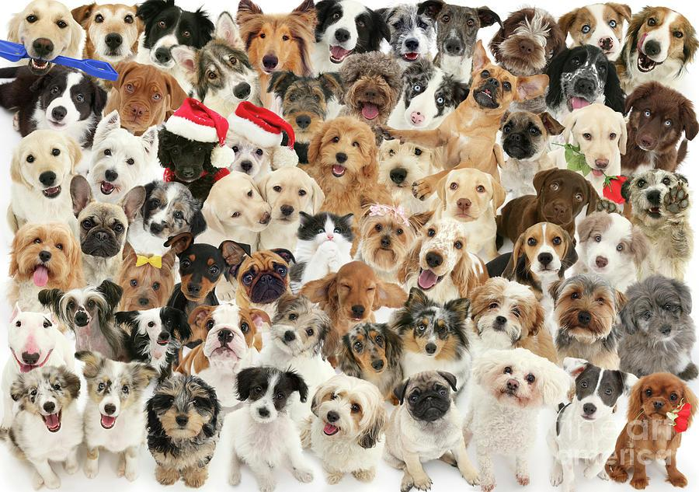
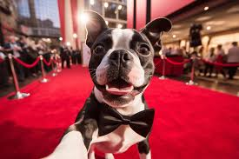
Goals
Learn from real-life examples of a subject
Synthesize a new subject

Slide 3
Method: Generative Adversarial Networks (GANs)
In a nutshell,
GANs take a value, apply a weight and generate a new value, using a Generator model. By adjusting those weights, it can eventually learn to make something meaningful, that can pass as real.
Weights are then adjusted using a Discriminator model. This model is trained to recognize what is and is not the target value(s).
These two model themselves are adversaries, since each wants to trick the other, which we can exploit to produce valuable results.

Slide 4
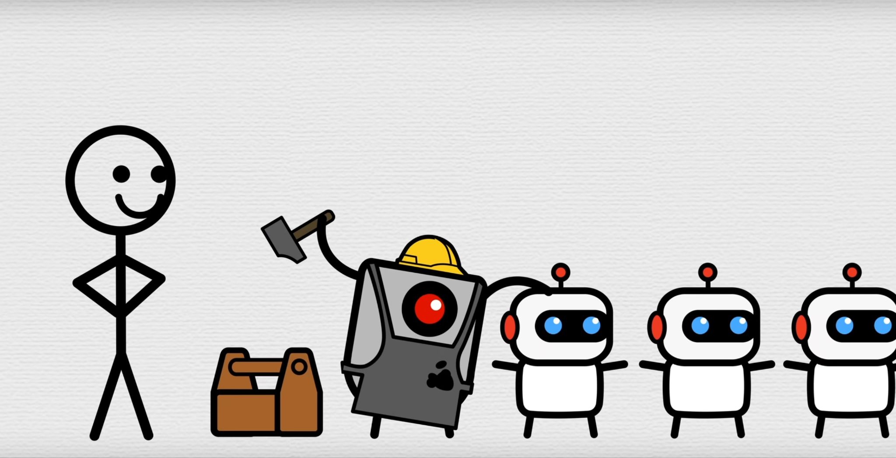
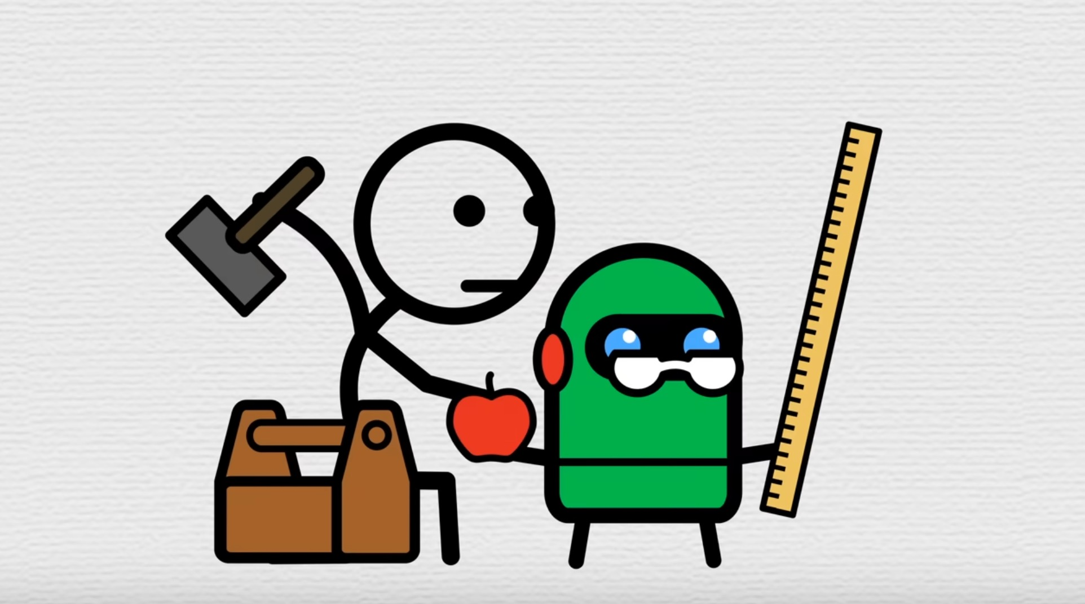
Example
Generator creates target objects, first at random, then with learned weights. Its goal is to synthesize something that can pass the Discriminator’s judgement.
Then the Discriminator judges those objects, and determines if they are real or fake.
Simple right? no.

Slide 5
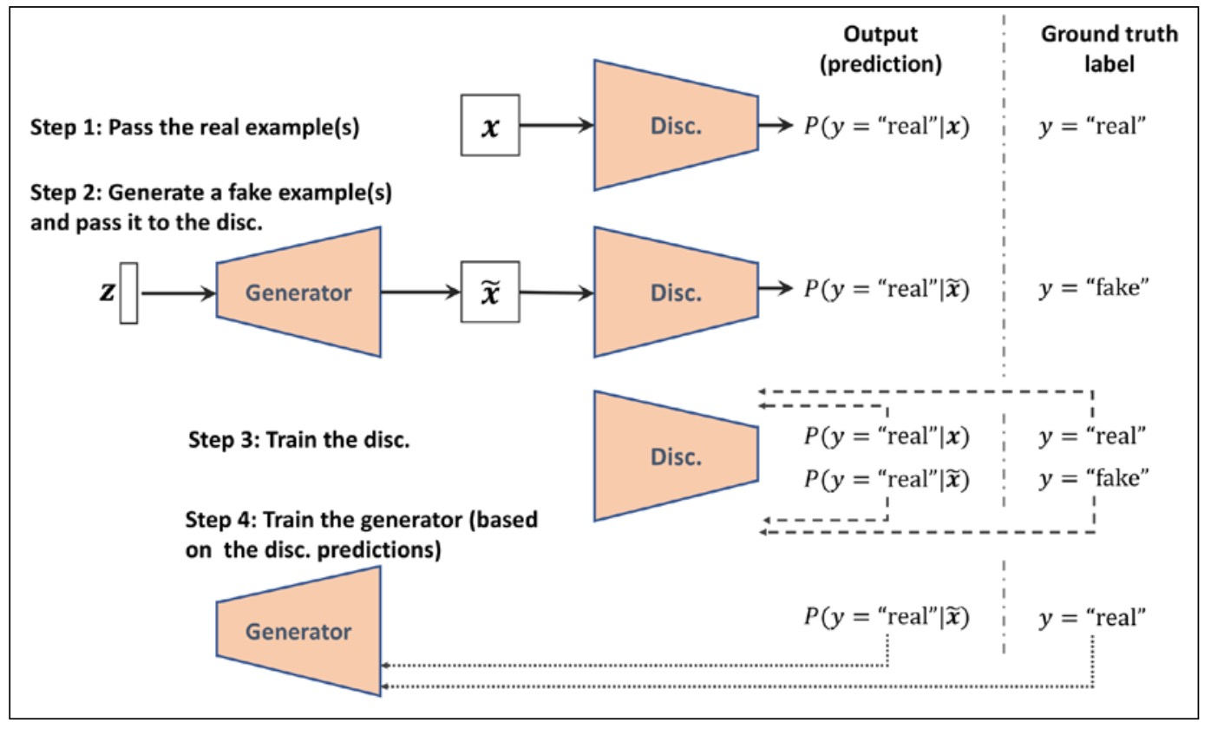
In the Real World

Slide 6
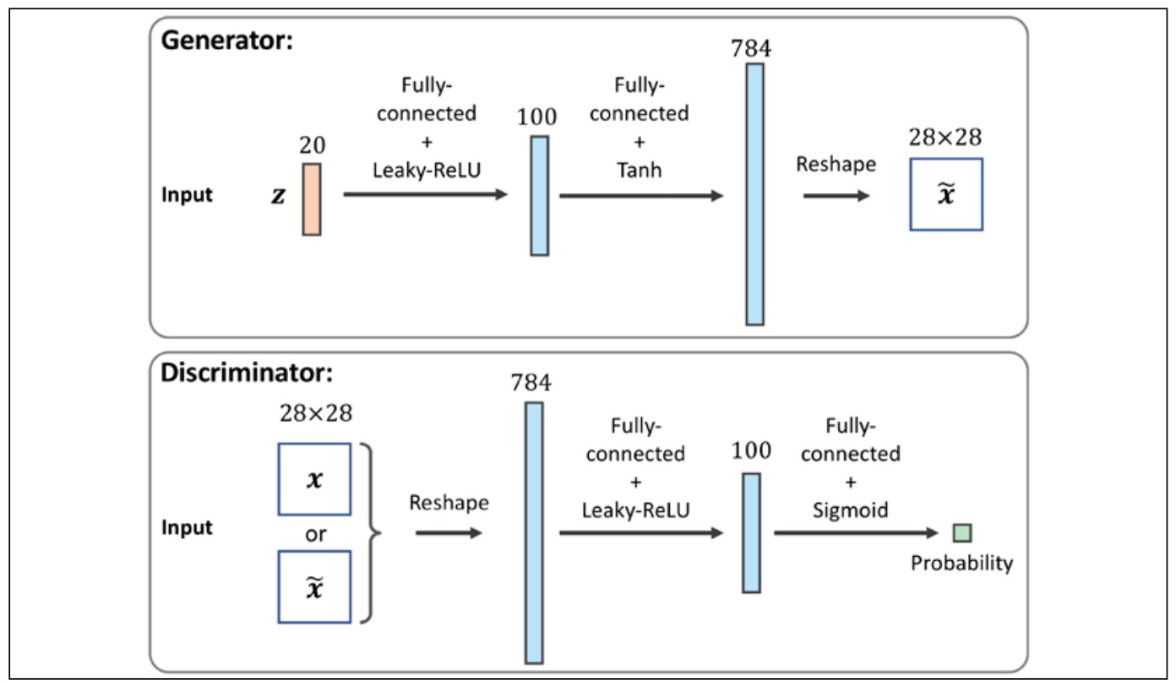
In the Real World…

Slide 7
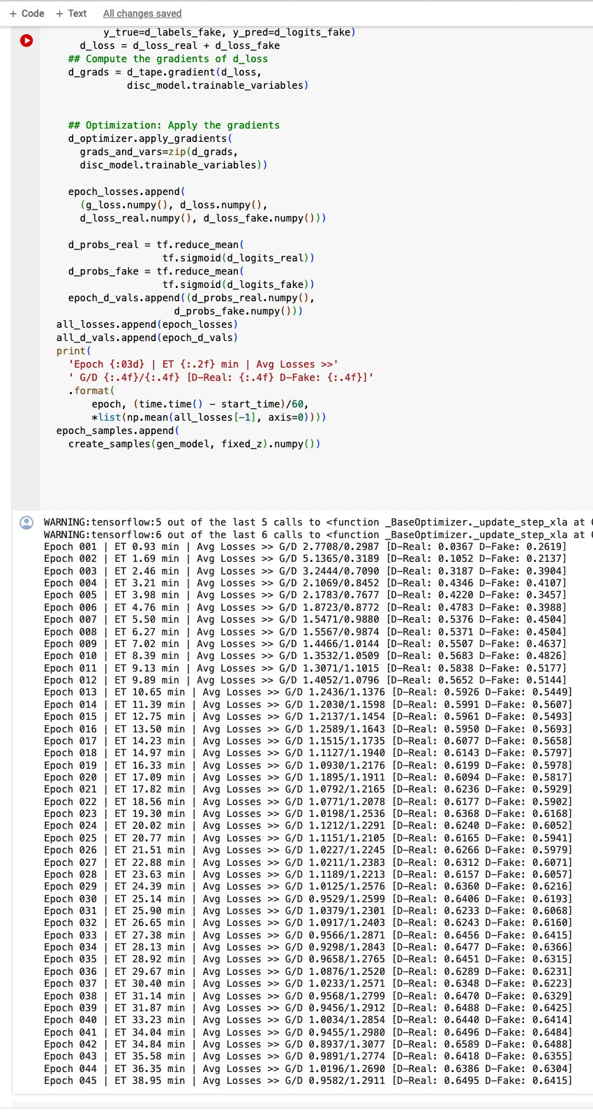
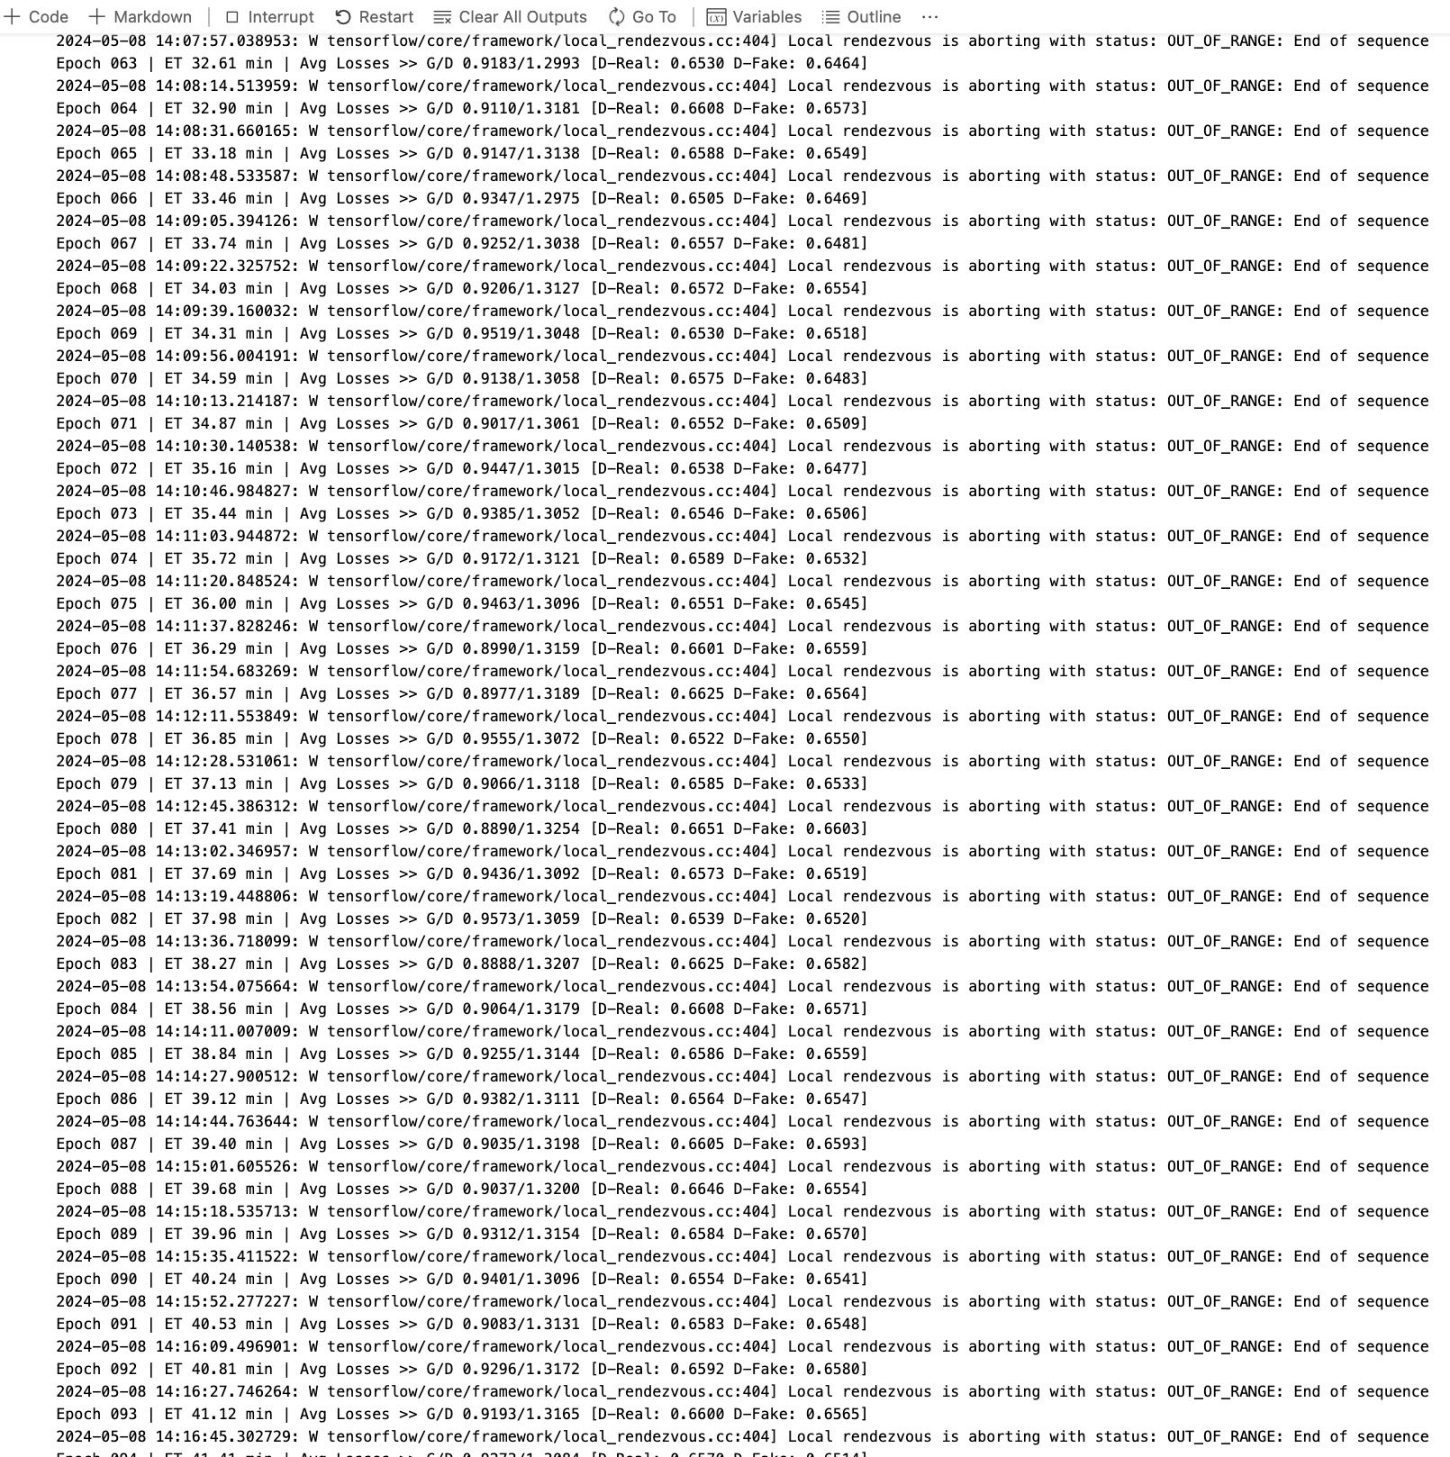
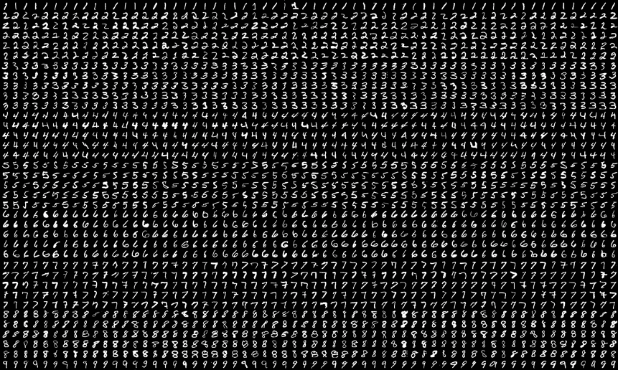
In the Real World… it takes a lot of time, computation, and data!

Slide 8
Let's Look at the Code…

Slide 9
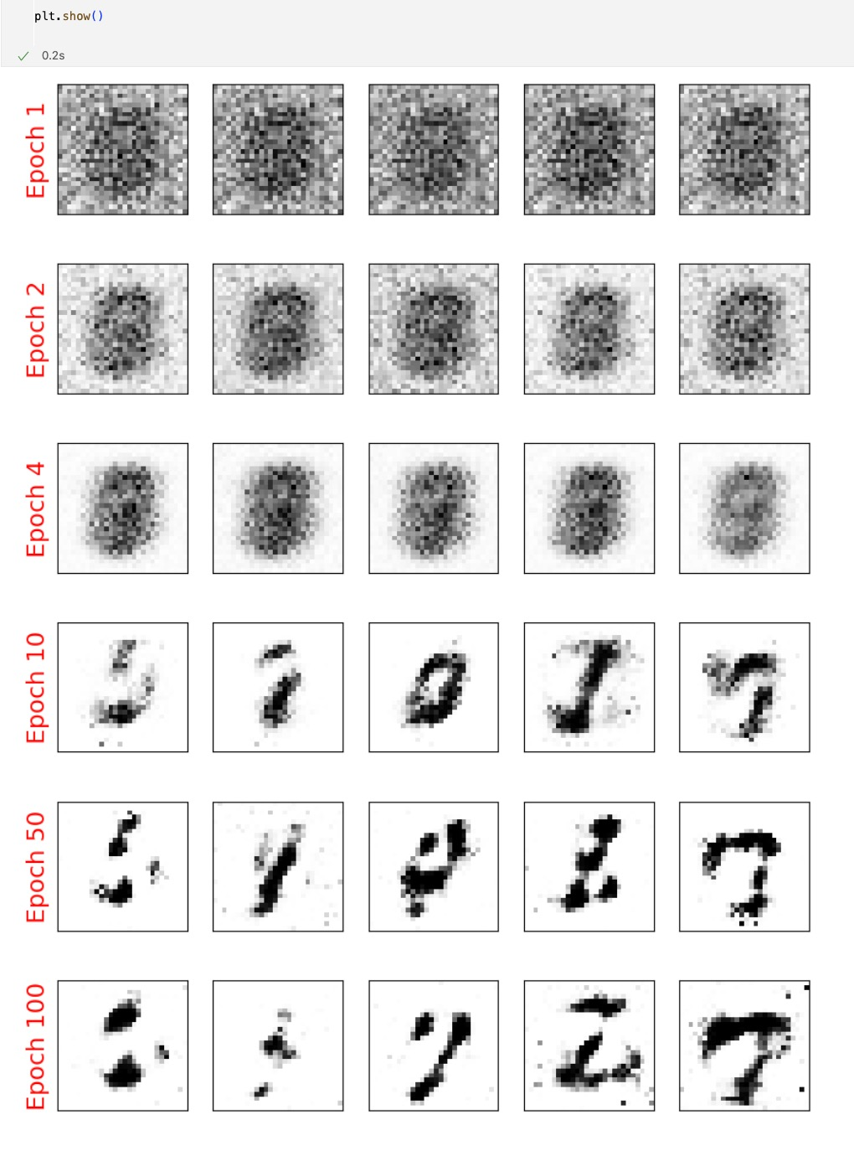
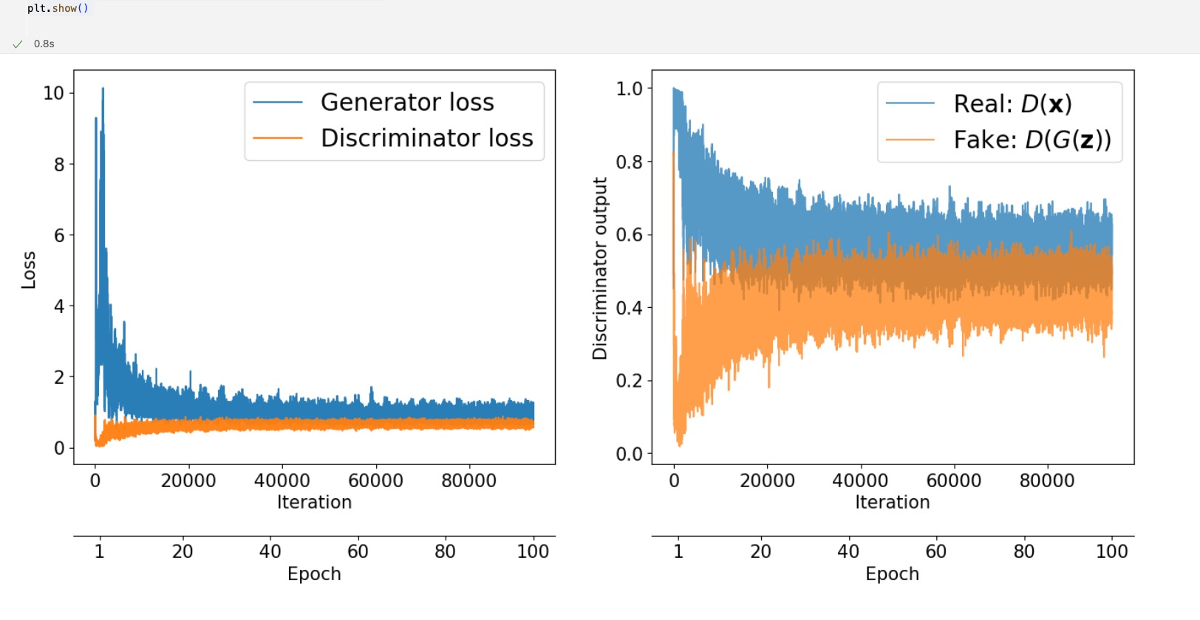
Results Pre-Optimizations
As the iterations go on, the Generator becomes better, and it ‘beats’ the Discriminator more often

Slide 10
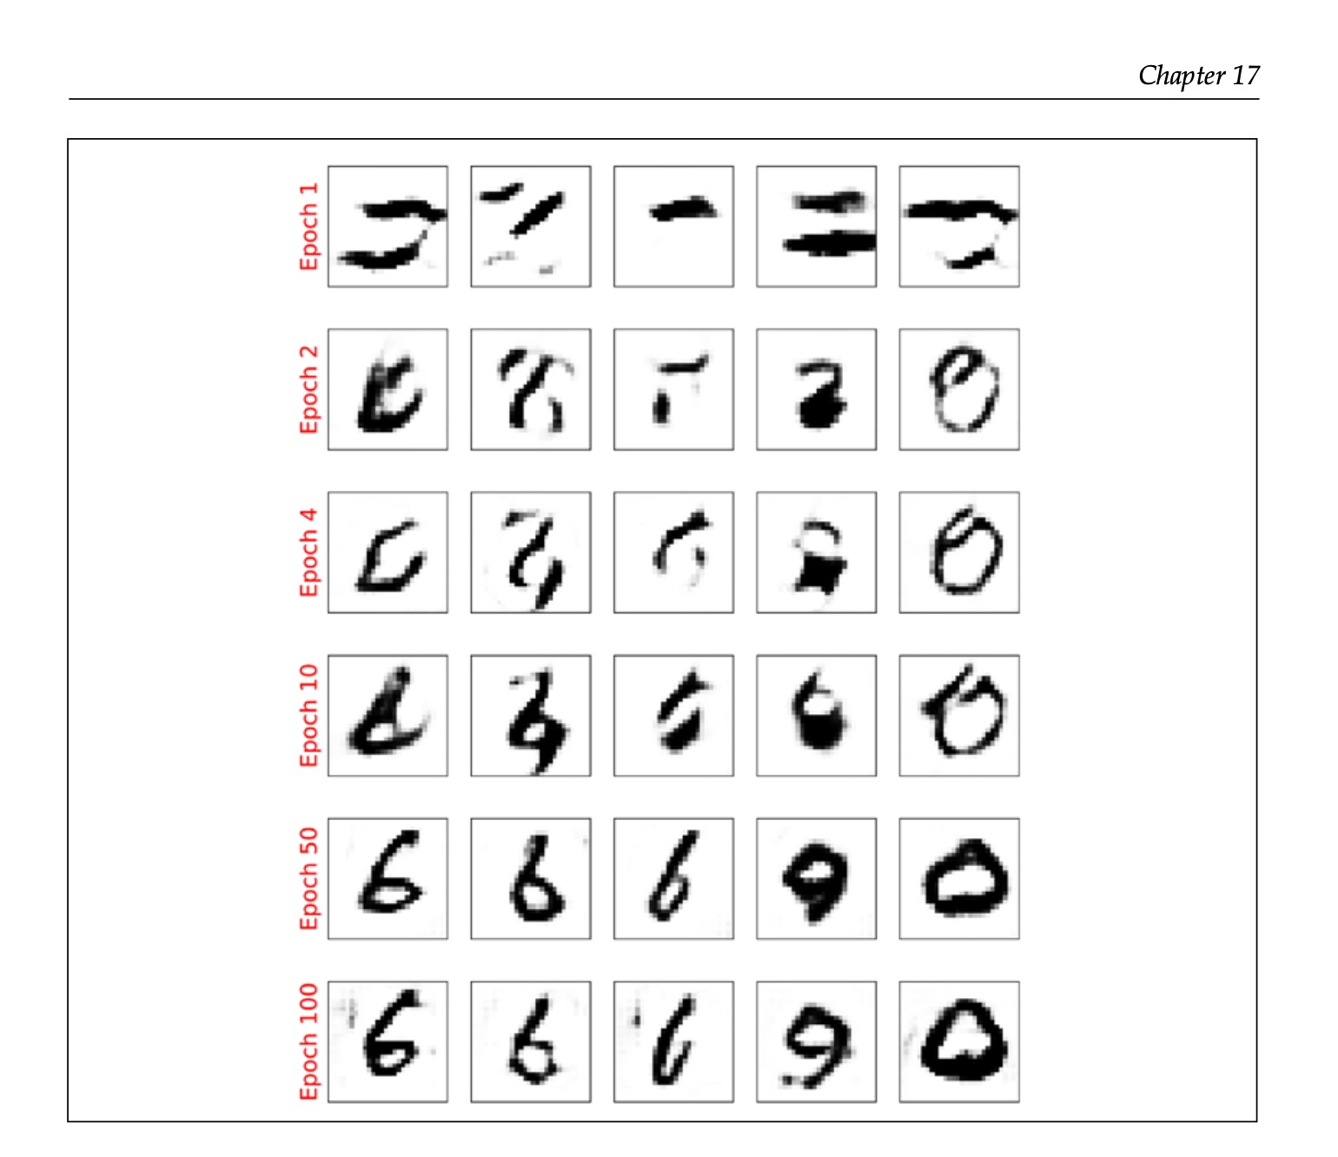
Target Results, post-optimization
These techniques can be used to recognize anything we can record data on.
However, as beneficial as these results are, fake information can be dangerous.

